Slide 1
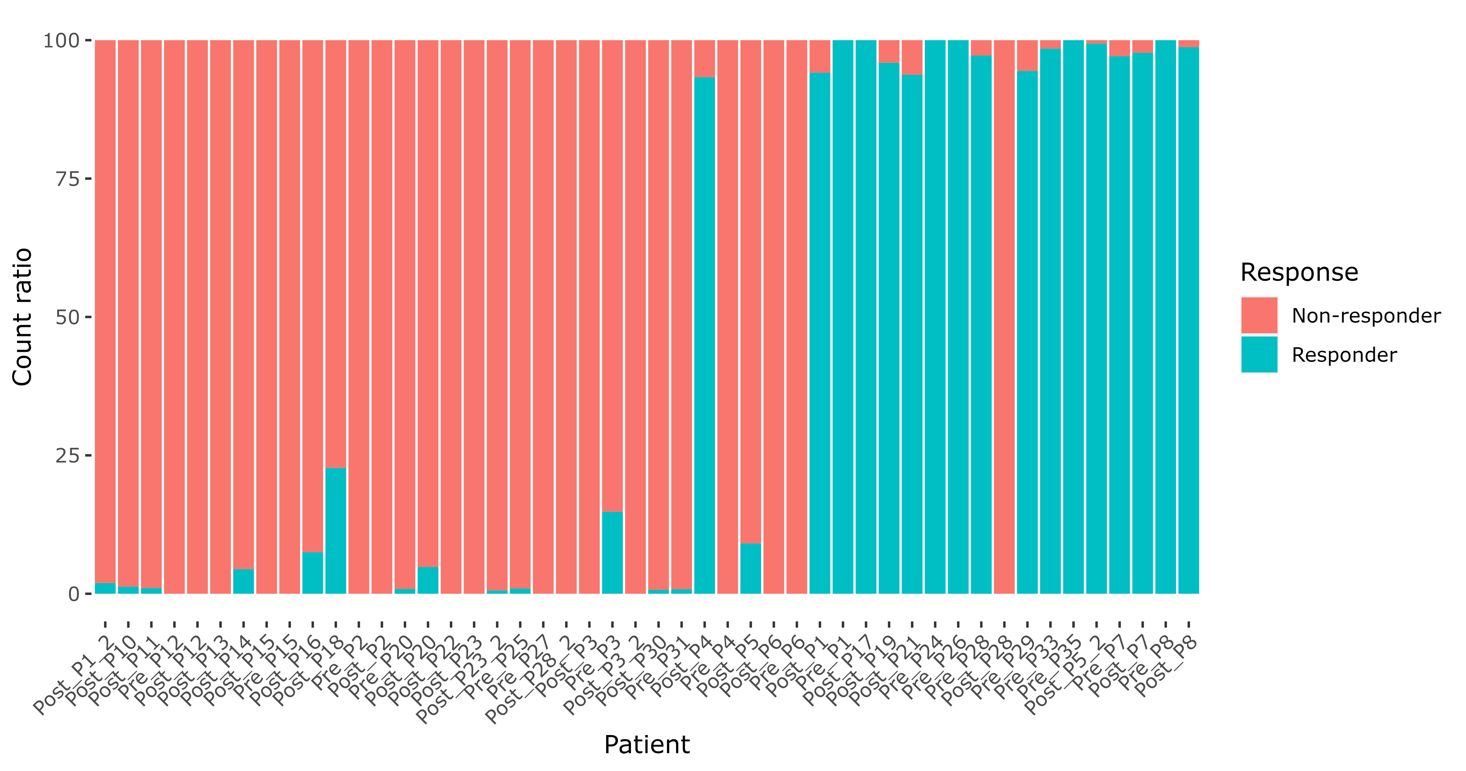
a PENCIL is sensitive to the class_weights (cw) parameter setting
Non-responder (4301)
Responder (2049)
Non-responder (2560)
Responder (9)
Rejected (3781)
Non-responder (2365)
Responder (1004)
Rejected (2981)
Non-responder (1911)
Responder (18)
Rejected (4421)
True label
cw = 1:1 (default)
cw = 2:1
cw = 4301/2049:1
b PENCIL is sensitive to input gene order
Non-responder (2006)
Responder (674)
Rejected (3670)
Non-responder (2078)
Responder (2)
Rejected (4270)
Non-responder (2425)
Responder (1135)
Rejected (2790)
Non-responder (1843)
Responder (504)
Rejected (4003)
Genes ordered by variance (low to high)
Genes ordered by mean expression (high to low)
Genes ordered by mean expression (low to high)
Genes ordered by name (A to Z)
c PENCIL is sensitive to input cells
Non-responder (1110)
Responder (14)
Rejected (3345)
Non-responder (2958)
Responder (1166)
Rejected (3034)
Non-responder (2767)
Responder (52)
Rejected (5724)
70% samples (using original CD8T annotation)
All samples (CD8T annotated by celltypist)
All samples (CD8T annotated by singleR)
d Generalizability of PENCIL on new data (cancer type: skin; phenotype: ICB response)
Sade-Feldman et al. (train)
*** (test1)
*** (test2)
e Generalizability of PENCIL on new data (cancer type: HNSCC; phenotype: HPV infection)
Sade-Feldman et al. (train)
*** (test1)
*** (test2)
Figure 1. A general usage report of PENCIL.
Notes:
Hi everyone, today I will present our recent work on predict pan-cancer ICB response using machine learning.

Slide 2
a
UMAP
clustering
UMAP
differential cell abundance test
Cluster annotation
UMAP
Make reference
Predict on new data
Downstream analysis
UMAP
Sample level phenotype prediction
DEG analysis
Pathway analysis
Signature making
b
Phenotype-related cell identification
Dataset 1
UMAP
Cluster annotation
UMAP
Dataset 4
UMAP
Phenotype-related cell identification
Dataset 2
UMAP
Cluster annotation
UMAP
Dataset 5
UMAP
Phenotype-related cell identification
Dataset 3
UMAP
Cluster annotation
UMAP
Dataset 6
UMAP
Training
Test
Figure 2. A simple method identifying phenotype-related cells.
Notes:
Hi everyone, today I will present our recent work on predict pan-cancer ICB response using machine learning.

Slide 3
Notes:
Hi everyone, today I will present our recent work on predict pan-cancer ICB response using machine learning.

Slide 4
Notes:
Hi everyone, today I will present our recent work on predict pan-cancer ICB response using machine learning.

Slide 5
Notes:
Hi everyone, today I will present our recent work on predict pan-cancer ICB response using machine learning.

